Slide 1



Exploring Advanced RAG Techniques
This tutorial explores advanced Retrieval-Augmented Generation (RAG) techniques. We aim to integrate these methodologies into your projects.
by Farid Ghorbani
FG

Slide 2

What is RAG?
1
Definition
RAG combines search capabilities with Large Language Models.
2
Application
Ideal for chatbots, virtual assistants, and question-answering systems.
3
Benefits
Enhances relevance and accuracy of generated responses.

Slide 3
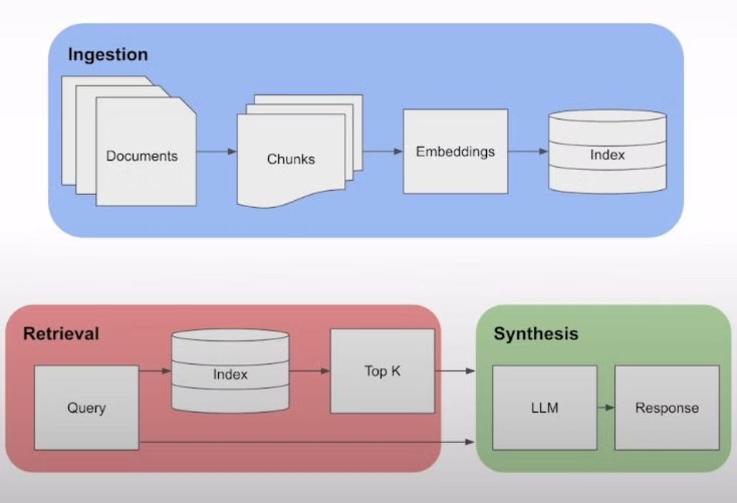
Simple RAG Workflow

Slide 4
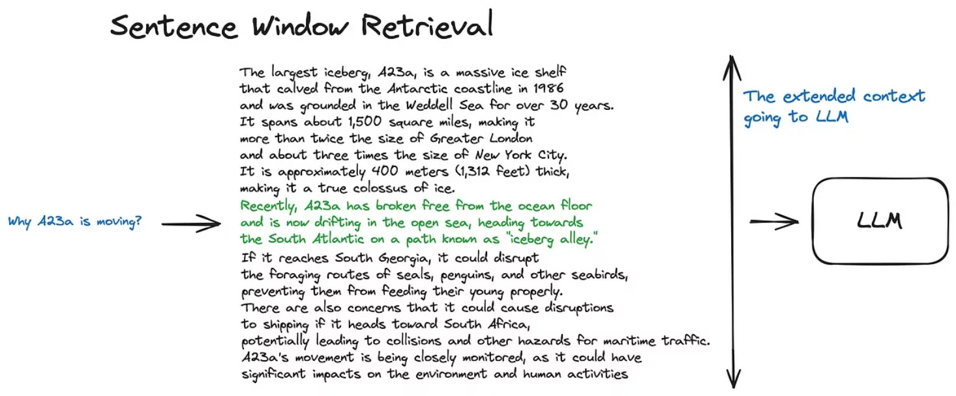
Advanced RAG Techniques
Sentence-Window-Retrieval

Slide 5
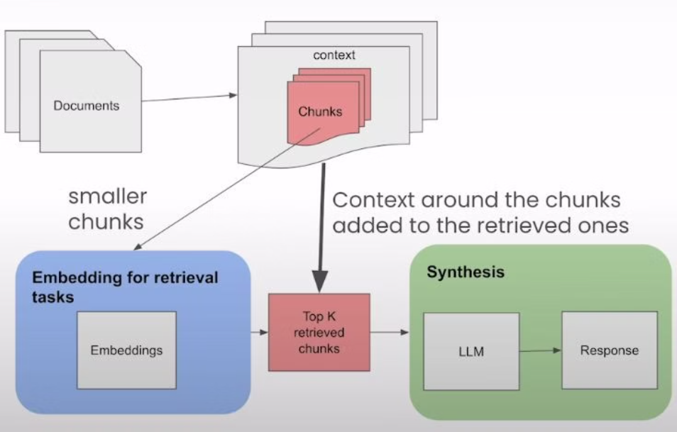
Advanced RAG Techniques
Sentence-Window-Retrieval

Slide 6
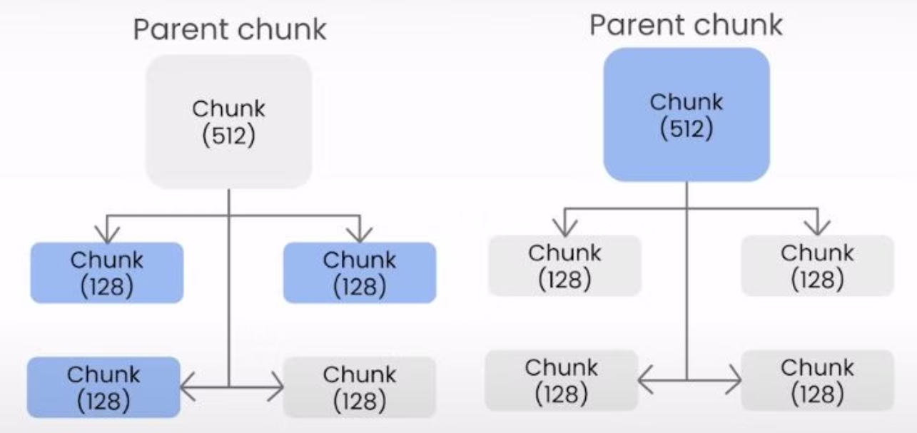
Sentence Window Retrieval
Auto-Merging Retriever

Slide 7
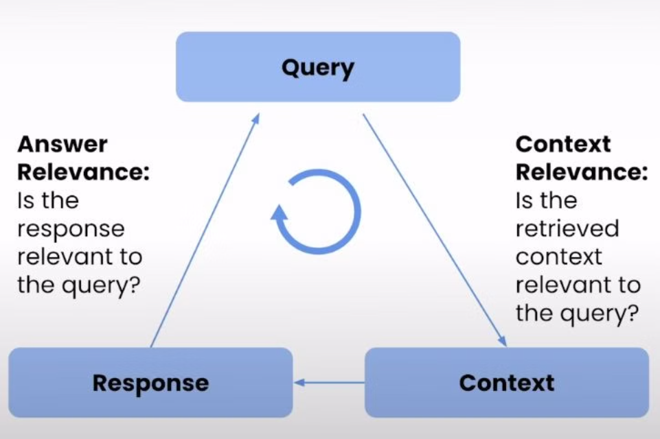
Evaluation of RAG Techniques

Slide 8

Summary of Index Retrieval Techniques
Improved Context Relevance
Enhances the accuracy of responses in RAG systems.
Key Techniques
Focus on Sentence Window and Auto-Merging methods.
User-Centric
The aim is to improve user satisfaction and engagement.

Slide 9

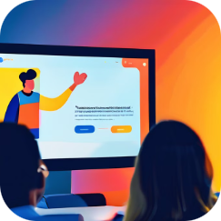
Thanks for watching
Further discussion
References
For evaluating and implementing these techniques in your projects, you can visit my GitHub repository linked in the description.
1- Advanced RAG Techniques: Unlocking the Next Level
2- Evaluating Advanced Retrieval Augmented Generation
3- Building and Evaluating Advanced RAG Applications

